Slide 1

CUSTOMER CHURN PREDICTION USING MACHINE LEARNING
BY
G. Sandilya Srinivas (17311A19E6)
S. LIKHIT KUMAR (17311A19E7)
J. PAVAN GANESH (17311A19G8)

Slide 2
CONTENT
ABSTRACT
INTRODUCTION
TECHNOLOGY STACK USED
BLOCK DIAGRAM
LIBRARIES REQUIRED
DATASET USED
IMPLEMENTATION
USE-CASE DIAGRAM
FUTURE SCOPE
CONCLUSION

Slide 3
ABSTRACT
Customer relations is of utmost importance for industries that directly provide goods and services to the people. The goodwill of the customers is what keeps the company up and running in many of the sectors such as telecom, banking, educational institutions, etc,. Various aspects like competitors, novel and innovative business models and enhanced services are increasing the cost of customer acquisition.
In such a fast set-up, service and goods providers have realized the importance of retaining the on-hand customers. Thus, establishing and maintaining good customer relations is the key for success of a company in today’s modern world of business.
We predict the customer churn rate, using Machine Learning models which will indicate whether a customer will leave the bank or not based on many factors, this in turn will help the bank in knowing which category of customers generally tend to leave the bank.
Further the banks can bring in exciting offers so that it can retain its customers. In this predictive process popular models such as logistic regression, decision trees, random forest and other boosting techniques have to be used to achieve a decent level of accuracy, for the banks to rely on so that they can clearly predict which customer may leave next based on customer data available.

Slide 4
INTRODUCTION
Customer churn, also known as customer attrition, which is the percentage of customers that stopped using a company’s service during a particular period.
Keeping churn rates as low as possible is what every business pursuits, and understanding these metrics can assist companies to identify potential churners in time to prevent them from leaving the client base.
By being aware of and monitoring churn rate, organizations are equipped to determine their customer retention success rates and identify strategies for improvement.
Various organizations calculate customer churn rate in a variety of ways, as churn rate may represent the total number of customers lost, the percentage of customers lost compared to the company’s total customer count, the value of recurring business lost, or the percent of recurring value lost.
One of the most commonly used methods for calculating customer churn is to divide the total number of clients a company has at the beginning of a specified time period by the number of customers lost during the same period.

Slide 5

TECHNOLOGY STACK USED
PYTHON PROGRAMMING
Python is used as it has a lot of built-in libraries which we will use to develop ‘Customer Churn Prediction System’.
We will be needing Python 3.6 and higher versions.

Slide 6

JUPYTER NOTEBOOK
The Jupyter Notebook is an open source web application that you can use to create and share documents that contain live code, equations, visualizations, and text.
Jupyter Notebook is maintained by the people at ‘Project Jupyter’.
The name, Jupyter, comes from the core supported programming languages that it supports: Julia, Python, and R.

Slide 7
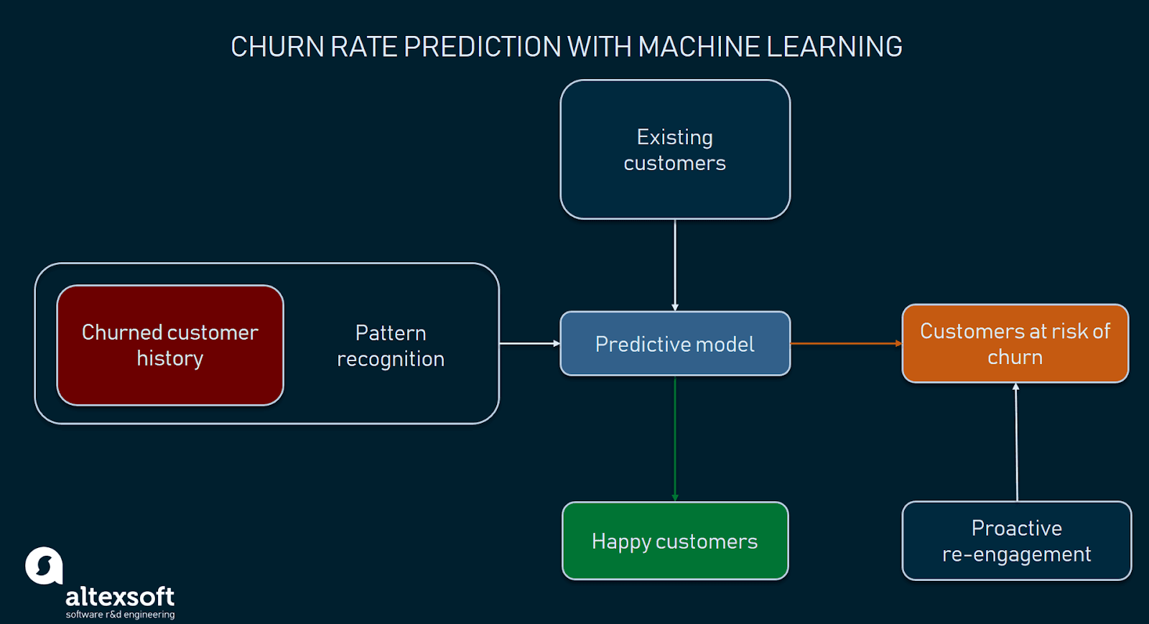
BLOCK DIAGRAM

Slide 8
LIBRARIES REQUIRED
The basic libraries used are:
Pandas
Numpy
Seaborn
Matplotlib

Slide 9
The Machine Learning libraries used are:
Logistic Regression
K-Neighbors Classifier
AdaBoost
Decision Tree Classifier
Random Forest Classifier
XGB Classifier

Slide 10
All the above libraries are inbuilt libraries of python.
We need to import them from Scikit-Learn.
Scikit-learn library which is commonly known as sklearn is a free software machine learning library for the Python programming language. It features various classification, regression and clustering algorithms

Slide 11
DATASET USED
This Dataset is an open-source dataset which is obtained from Kaggle.
The name of the Dataset used is “Bank Customer Churn Data”.
This dataset contains 10000 records and 14 features.
The features of this dataset are:
'RowNumber', 'CustomerId', 'Surname', 'CreditScore', 'Geography', 'Gender', 'Age', 'Tenure', 'Balance', 'NumOfProducts', 'HasCrCard', 'IsActiveMember', 'EstimatedSalary', 'Exited’ .
Out of these, Surname, Geography and Gender are string data which need on which encoding will be performed.
This data does not contain any missing values. So, no imputations need to done.
The Target variable is the “Exited” variable which indicates whether a customer has left and which customer is with the bank.

Slide 12
IMPLEMENTATION
We chose “Python” as our base programming language to proceed with building the model as stated earlier in this presentation.
Scikit Learn library provides all the necessary machine learning models that will be used in this project.
Before giving data to the model, there are a lot of data pre-processing steps that need to be done in order to achieve the maximum accuracy with the models that we have selected.
Data pre-processing is the most basic and important step in any machine learning project.

Slide 13
Data Pre-Processing Steps:
Data cleaning.
Data Imputation
Dealing with outliers
Data Transformation
Data visualization
After these steps, comes the ML modelling part where we train our model according to our data and then test it on same data which is separated before hand.

Slide 14
USE-CASE DIAGRAM

Slide 15
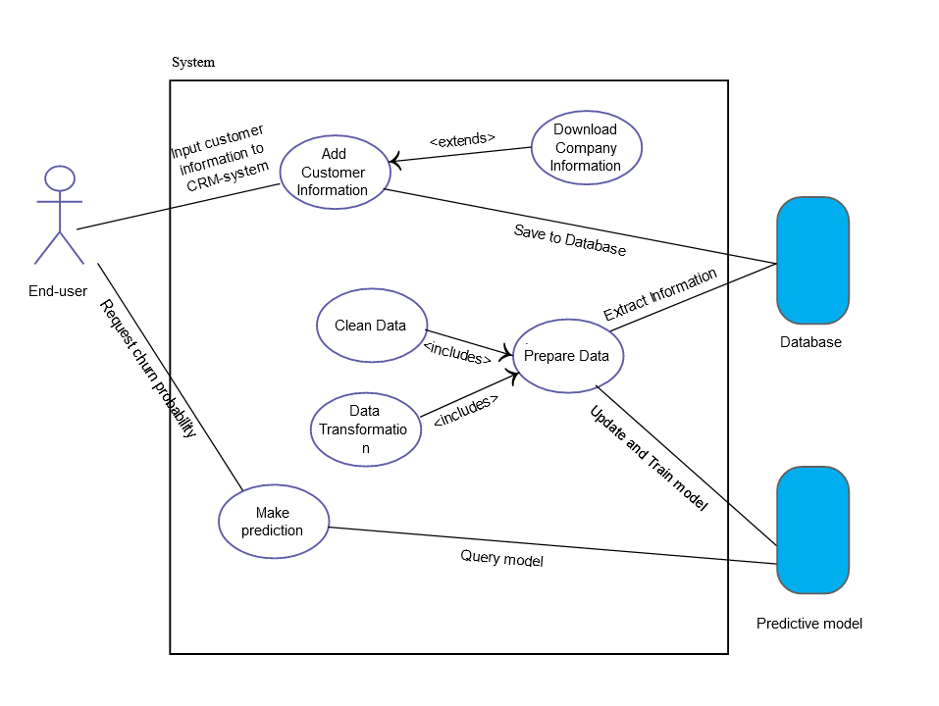

Slide 16
FUTURE SCOPE
The process of predicting churn rate by years i.e. specifically it is aimed at predicting in advance where customers are likely to leave a bank with quite good precision, avoiding costs related to false positive errors.
When the customers leave there’s a huge loss to the bank ,it should reimburse with the percentage of new customers.

Slide 17
CONCLUSION
Churn rate is a health indicator for subscription-based companies. The ability to identify customers that aren’t happy with provided solutions allows businesses to learn about product or pricing plan weak points, operation issues, as well as customer preferences and expectations to proactively reduce reasons for churn.
It’s important to define data sources and observation period to have a history of customer interaction. Selection of the most significant features for a model would influence its predictive performance: The more qualitative the dataset, the more precise forecasts are.
Companies with a large customer base and numerous offerings would benefit from customer segmentation. The number and choice of ML models may also depend on segmentation results. Data scientists also need to monitor deployed models, and revise and adapt features to maintain the desired level of prediction accuracy.

Slide 18


